Slide 1
SRE from scratch: an enterprise journey
Monika Gupta SRE Lead – MOBIUS Platform and Tools , BT
Avinash Rao
VP Products, Digite Inc

Slide 2
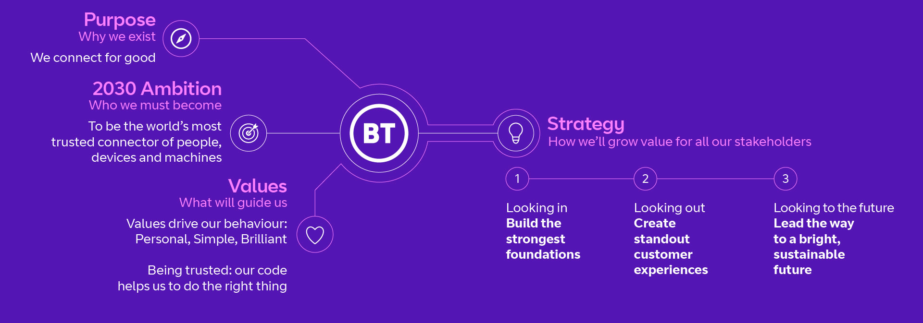
BT’s Purpose and Strategy
Our three-pillar strategy is how we’ll realise our ambition, growing value for all stakeholders

Slide 3
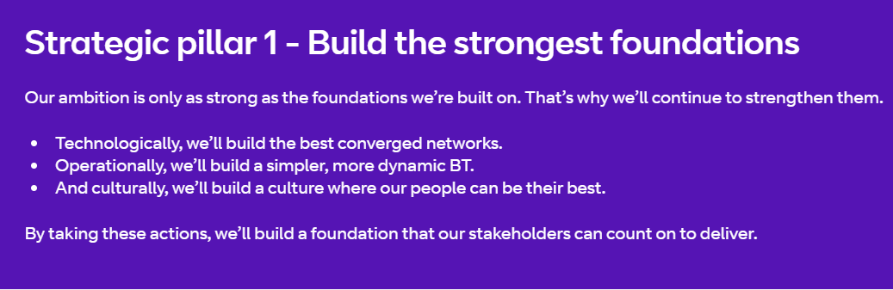
BT’s Purpose and Strategy

Slide 4
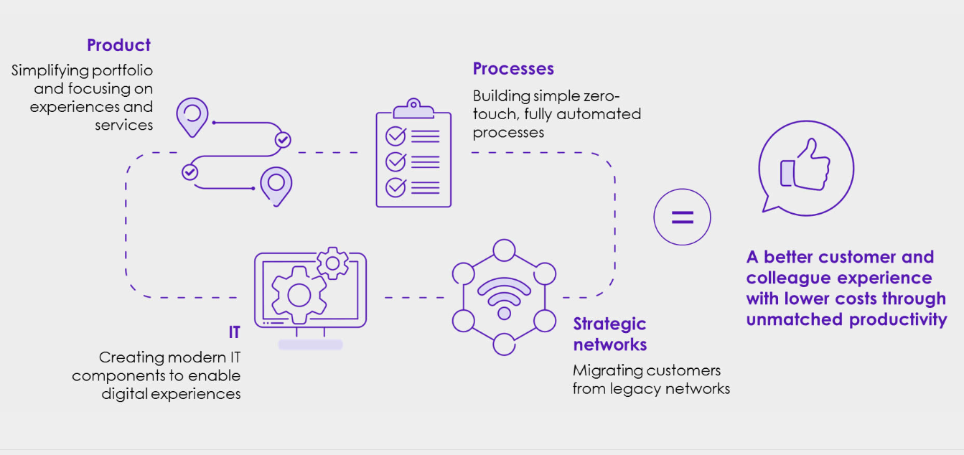
Simpler, more Dynamic BT

Slide 5

A culture where people can be their best

Slide 6
Goal posts at the start of MOBIUS Program
DevOps & CI-CD
Component Level adoption of CI-CD practices
BT wide common definition of DevOps not in place
No Structured visibility on various DevOps capabilities and its adoption
Continuous Testing
Test automation capability enabled through testing CoE .
Shift Left testing and In sprint test automation capabilities to be created
Pipeline based Test automation not in place
Release Management
Release wait time for most of the components, due to overlap between Org wide Release plans.
Build for traditional Release management practices needs to be redefined for New Ways of Working
Agile Process
New environment creation process is Manual takes 15 days for creation and 1 day for enablement of virtual servers
Unit testing is manual
KM Process are defined at component level with partial compliance
Cloud Adoption
Structures Cloud adoption strategy in place and driven through CoE
Templatized migration and application refactoring in being defined
Automation
Unit testing is mostly manual. Manual intervention across software lifecycle.
Many activities of the SDLC is manually triggered of lack any significant automation.
Reusable automation scripts are not available pan BT
Automation First mindset not enforced with Engineering community
Visibility
Lack of Single source of truth for all Engineering reporting needs
Loss of Significant amount of time in building dashboards and updating reports
No Enterprise-wide reusable Dashboards for all engineering functions
Component level KPIs are measured. Reporting is mostly manual with various source of information.
Challenges
Lack of measurements
Lack of tooling governance
Localized Optimization
Automation silos and lack of reusability

Slide 7
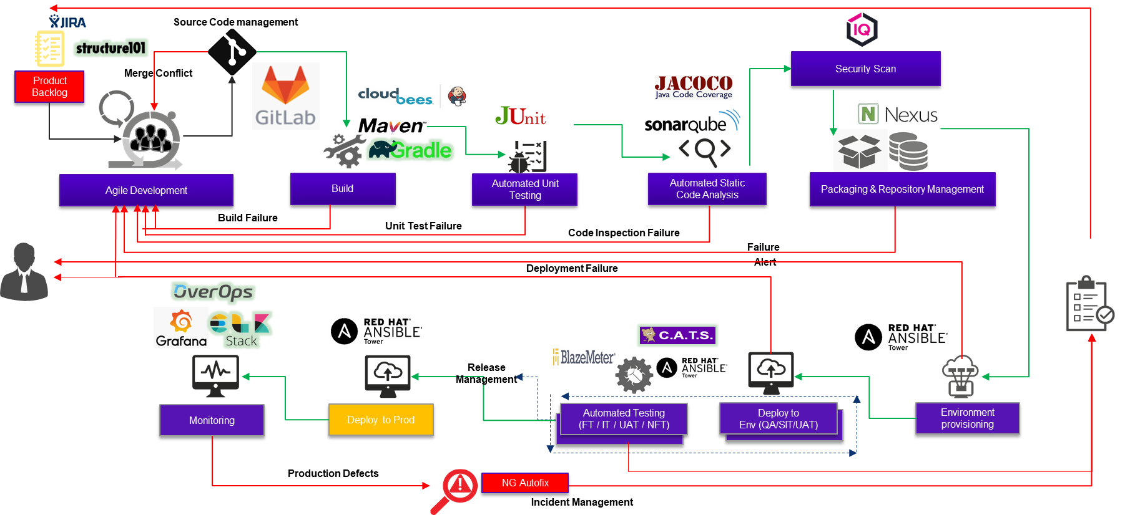

The Toolset for MOBIUS

Slide 8
This should be the slide for results, right? But we started seeing complaints about the stability of the MOBIUS platform from initial customers

Slide 9
The original structure was not conducive to SRE – Who owns the platform, really? Customer feedback Support tickets started piling up – but needed Platform help
Onboarding
Platform
Support
Core tools team

Slide 10
This led us to SRE
1/
Understanding SRE
2/
Moving from Reactive to Proactive Operating Model
3/
Implementation via Tools

Slide 11





@
SRE
Incubate
Adoption Phases
Bootstrap the SRE Model and Coach the teams
Assess
Map the current
State of ITSM Practices
Define
ADOPT
Determine the future state and the Milestones
Scale the practice across the Unit

Slide 12
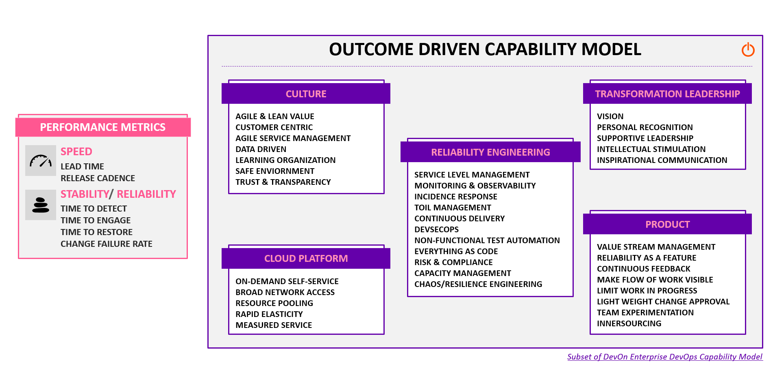


Slide 13

Reactive > Proactive > Preventive Reliability Engineering Model
The ask from the SRE team

Slide 14

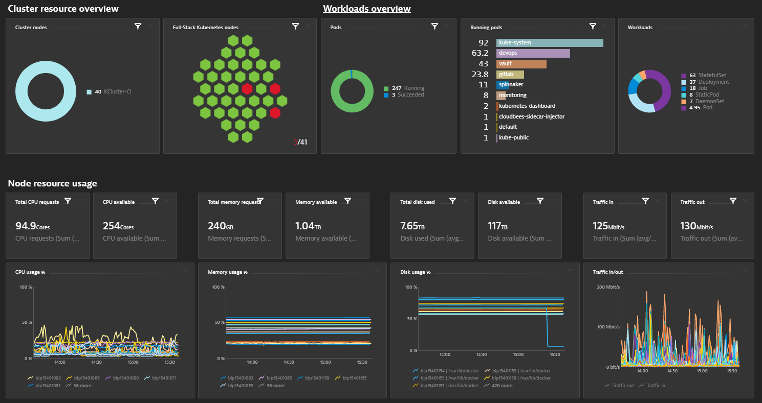






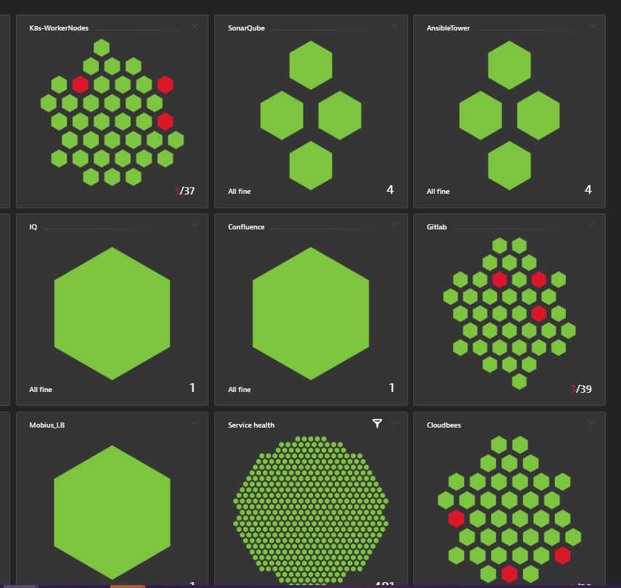


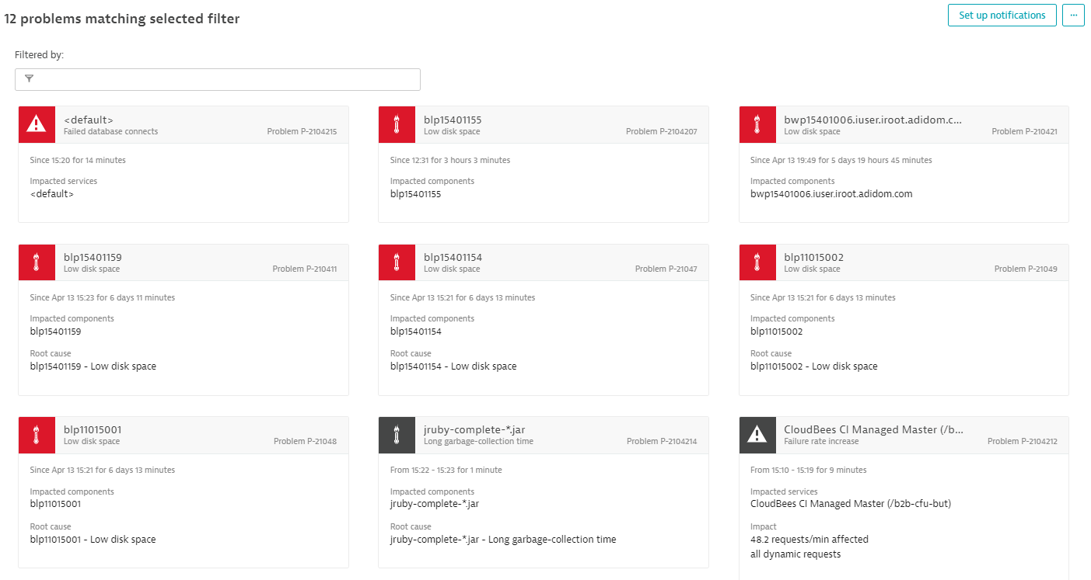

PROACTIVE RELIABILITY MONITORING
FROM REACTIVE TO
10
SLO Driven
289
TOOLS
MOBIUS & TOOLS
INFRASTRUCTURE
23500+
Toil
Identification
Real Time
Incident Response Tools Integration
(Pager Duty)
40
END USER 60%
K8 CLUSTER
40 120
MOBIUS PLATFORM
Capacity Prediction and Planning
Availability Metrics Dashboard
Alerts Triggers
Problem Management
Manual Incident Trigger
Observability
& Self Healing based Monitoring

Slide 15
PROACTIVE RELIABILITY MONITORING
FROM REACTIVE TO
10
SLO Driven
289
TOOLS
MOBIUS & TOOLS
INFRASTRUCTURE
23500+
Toil
Identification
Real Time
Incident Response Tools Integration
(Pager Duty)
40
END USER 60%
K8 CLUSTER
40 120
MOBIUS PLATFORM
Availability Metrics Dashboard
Alerts Triggers
Problem Management
Manual Incident Trigger
Observability
& Self Healing based Monitoring

Slide 16
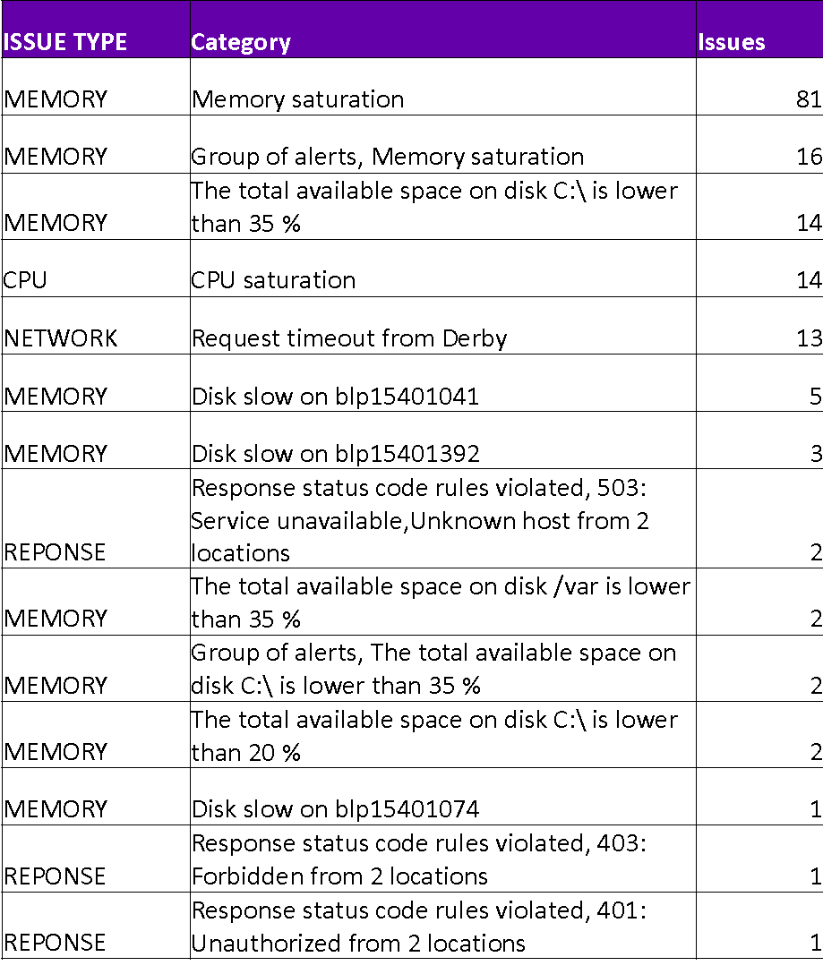
Learning: We have unearthed more problems in our digital estate than we initially expected! Extending monitoring in uncharted areas like Certificate Monitoring
Next Steps

Slide 17
PROACTIVE RELIABILITY MONITORING
FROM REACTIVE TO
10
SLO Driven
289
TOOLS
MOBIUS & TOOLS
INFRASTRUCTURE
23500+
40
END USER 60%
K8 CLUSTER
40 120
MOBIUS PLATFORM
Capacity Prediction and Planning
Alerts Triggers
Problem Management
Manual Incident Trigger
Observability
& Self Healing based Monitoring

